Slide 1

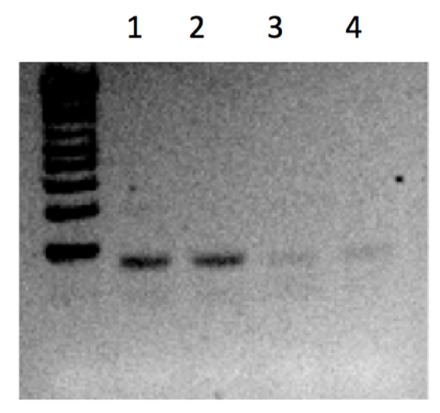
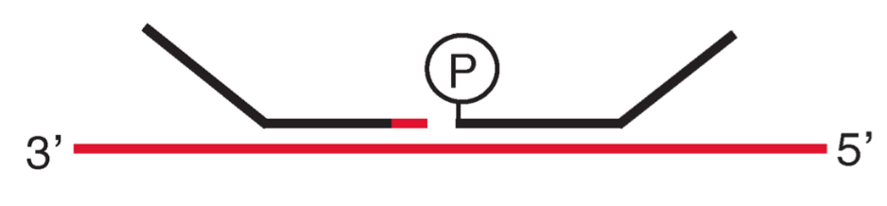
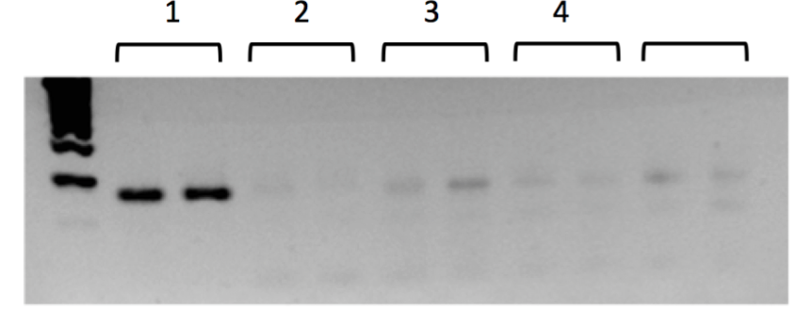
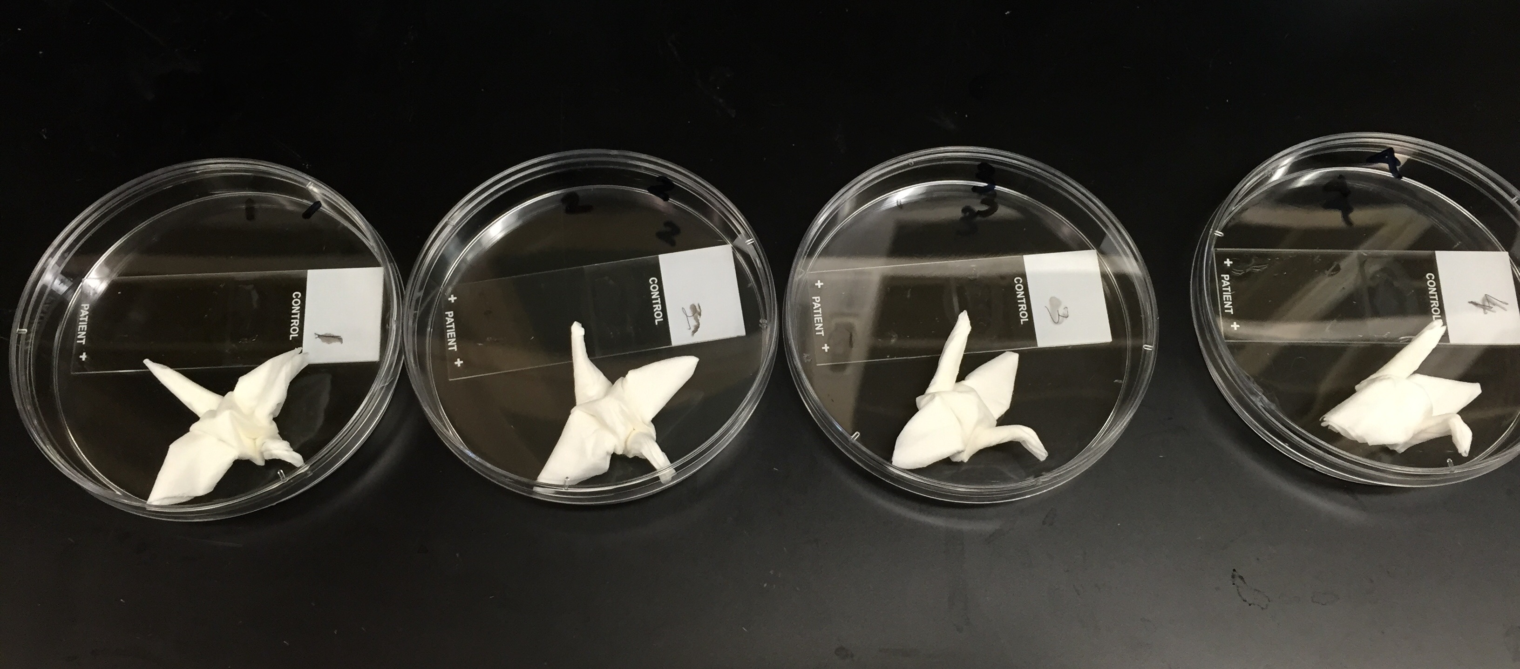
Ligation In-situ Hybrdization
Christopher Itoh¹, Joel Credle¹, Rajni Sharma², H. Benjamin Larman¹
¹ Department of Immunopathology, Johns Hopkins University School of Medicine, Baltimore, MD, USA;
²Surgical Pathology Laboratory, Johns Hopkins Hospital, Baltimore, MD, USA
Introduction
Universal
Primer Binding Site
Materials and Methods
Results
Transcriptomics is the study of RNA expression produced by the genome. This allows the understanding of vital cell molecular mechanisms and processes, such as differentiation, signaling pathways, and biomarkers for disease. One conventional method to study and quantify the transcriptome includes using Reverse Transcription (RT) and quantitative PCR (qPCR). However, Reverse Transcriptase is inefficient at transcribing RNA from fixed cells due to cross-linking and RNA degradation. Instead of using RT-qPCR, we sought to develop a novel RNA measurement technology based on the use of complementary probes that can anneal adjacently on target RNA and become ligated using an RNA Ligase. The probes also including flanking regions with a known sequence, which we developed primers for sequencing. We tested this concept using fresh cell lysate, fixed and permeabilized cells, and formalin fixed paraffin embedded (FFPE) tissue biopsies.
For our proof-of-concept study, we designed two probes to target GAPDH, a housekeeping gene. Using PCR and gel electrophoresis, we determined that matched (versus unmatched) probe sets could be ligated and amplified using fixed RNA. This novel method may be a more effective and efficient approach for multiplex analysis of gene expression in fixed tissue specimens.
Probe:
T4 Rnl2 Ligase: Ligates 3’ RNA to 5’DNA
Model: (1) HEK 293T cells and (2) FFPE Human Muscle Tissue 4 μm section, acquired from Surgical Pathology Laboratory, Johns Hopkins Hospital
1) Fixed Cells
Template was fixed and permeabilized human 293T cells in suspension. Probes were ligated with 1 U Rnl2 in 20 μl for 30 min at 37C. After ligation, cells were used directly in the PCR reaction. The experiment was run in duplicate. Product was amplified by PCR and analyzed by gel electrophoresis.
2) FFPE Human muscle tissue
Template was 4 μm section from FFPE human muscle tissue. RNAscope hybridization condition was employed. Tissues were washed once in 1x ligase buffer at 37C for 30 min. Probes were ligated with 2.5 U Rnl2 in 50 μl for 30 min. Ligation product was released into solution by treatment with 1 ul RNAseH in 25 μl RT buffer for 30 min. Product was amplified by PCR and analyzed by gel electrophoresis.
RNA
1 2 3 4 5
Gene
Specific
Figure 1: Fixed HEK293T Cells (in duplicate)
  1: GAPDH_1_A + GAPDH_1_B
  2: GAPDH_2_A + GAPDH_2_B
  3: GAPDH_1_A + GAPDH_2_B (mismatch)
  4: GAPDH_2_A + GAPDH_1_B (mismatch)
  5: GAPDH_1_A + GAPDH_1_B (no cells)
Figure 2: FFPE Human Muscle Tissue
  1: GAPDH_1_A + GAPDH_1_B
  2: GAPDH_2_A + GAPDH_2_B
  3: GAPDH_1_A + GAPDH_2_B (mismatch)
  4: GAPDH_2_A + GAPDH_1_B (mismatch)
Conclusion
Fixed HEK293T cells in lane 1 (matched probes) showed evidence of ligation and amplification by PCR. However, lane 2 (also with matched probes) was unsuccessful in ligation and amplification. This could be due to the probes not being accessible to the cell after fixation and permeabilization. For lane 3, 4, and 5, which are negative controls, no signal were detected.
In FFPE Human muscle tissue slides, both lane 1 and lane 2 showed positive bands. In these cases, the matched probes successfully ligated and were amplified. In addition, lane 3 and lane 4, which used mismatched probe sets, did not show any signal. Ligation in-situ hybridization was successful on FFPE slides.
Objectives
Perform proof-of-principle experiments to assess “Ligation In-situ Hybridization” (LISH) for measurement of gene expression in (1) fixed suspension cells and (2) FFPE human muscle tissue.
References
Acknowledgements
Larman HB, Scott ER, Wogan M, Oliveira G, Torkamani A, et al. Sensitive, multiplex and direct quantification of RNA sequences using a modified RASL assay. Nucleic Acids Res. 2014 Aug;42(14):9146-57. PubMed PMID: 25063296; PubMed Central PMCID: PMC4132746.
Thanks to Dr. H. Benjamin Larman for his mentorship, advice, and support. Also, thanks to Dr. Rajni Sharma for preparing the tissue slides. Thanks to Joel Credle for his input. Lastly, thanks to the Johns Hopkins Pathology Department for funding.

